Slide 1
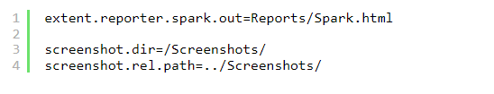
ExtentReports Version 5 for Cucumber 7 and TestNG
New Features in ExtentReports Version 5
Report Attachments
To add attachments, like screen images, two settings need to be added to the extent.properties. Firstly property, named screenshot.dir, is the directory where the attachments are stored. Secondly is screenshot.rel.path, which is the relative path from the report file to the screenshot directory.
Extent PDF Reporter
The PDF reporter summarizes the test run results in a dashboard and other sections with feature, scenario, and, step details. The PDF report needs to be enabled in the extent.properties file.

Slide 2


Ported HTML Reporter
The original HTML Extent Reporter was deprecated in 4.1.3 and removed in 5.0.0. The HTML report available in the adapter is based on the same code base and is similar in appearance. The major changes are in the Freemarker template code which has been modified to work with the Extent Reports version 5. The HTML report needs to be enabled in the extent.properties file.
Customized Report Folder Name
To enable the report folder name with date and\or time details, two settings need to be added to the extent.properties. These are basefolder.name and basefolder.datetimepattern. These will be merged to create the base folder name, inside which the reports will be generated.

Slide 3


Attach Image as Base64 String
This feature can be used to attach images to the Spark report by setting the src attribute of the img tag to a Base64 encoded string of the image. When this feature is used, no physical file is created. There is no need to modify any step definition code to use this. To enable this, use the below settings in extent.properties, which is false by default.
Environment or System Info Properties
It is now possible to add environment or system info properties in the extent.properties or pass them in the maven command line.

Slide 4

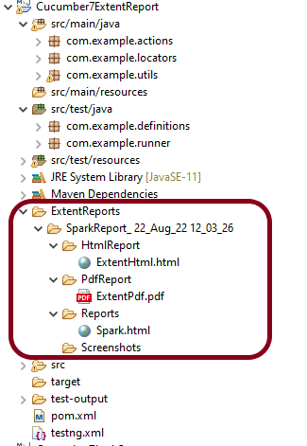

Slide 5
The ExtentReport will be present in the Reports folder with the name Spark.html. PDF Report is present in PdfReport folder and HTML Report is present in HtmlReport folder. We can see that the Screenshots folder is empty because we have used base64imagesrc feature that results in no physical screenshots. The screenshots are embedded in the reports.
Right-click and open the ExtentHtml.html report with Web Browser. The report also has a summary section that displays the summary of the execution. The summary includes the overview of the pass/fail using a pictogram, start time, end time, and pass/fail details of features as shown in the image below.
ExtentHtml.html

Slide 6
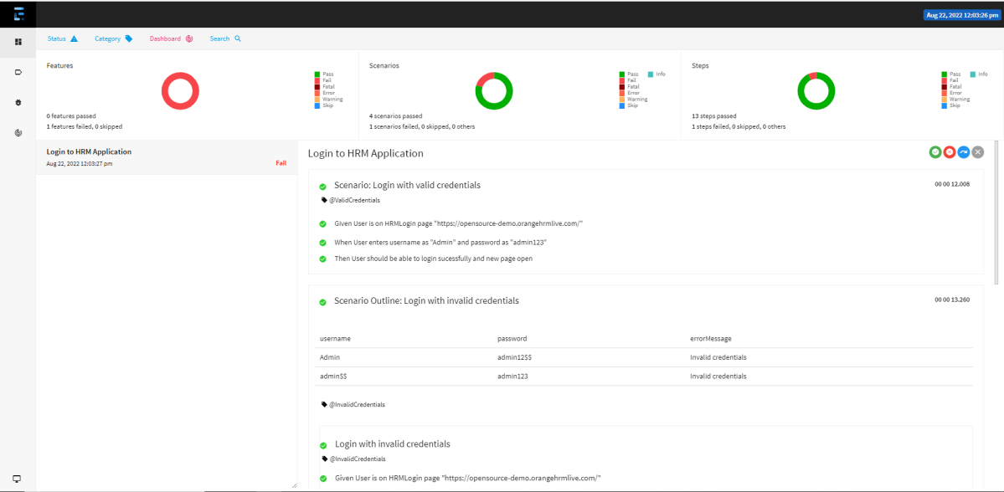

Slide 7
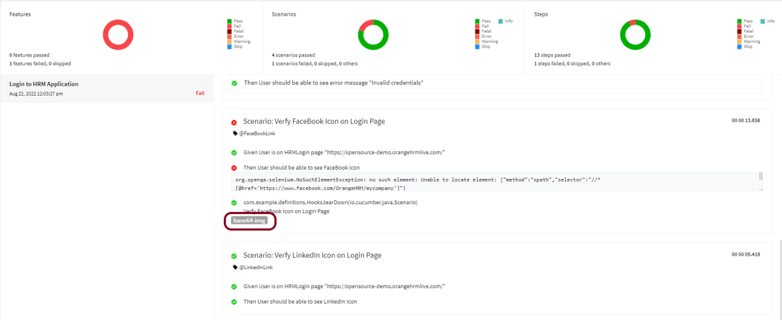
The failed test has a screenshot embedded in it. Double-click on mase64image and it will open the screenshot in full screen.

Slide 8
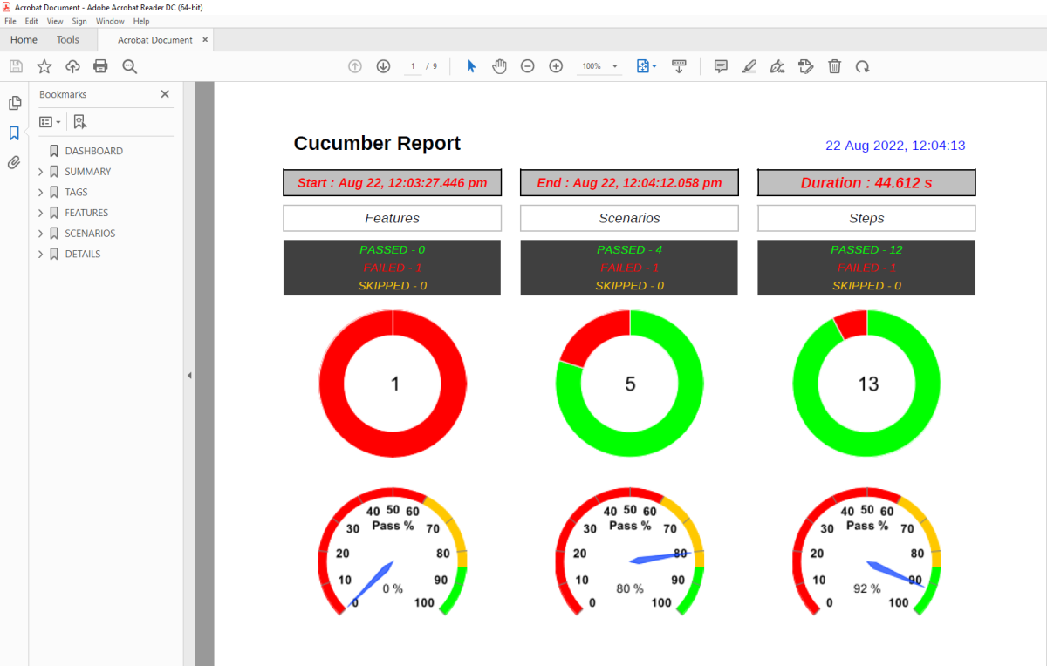
PDF Report

Slide 9
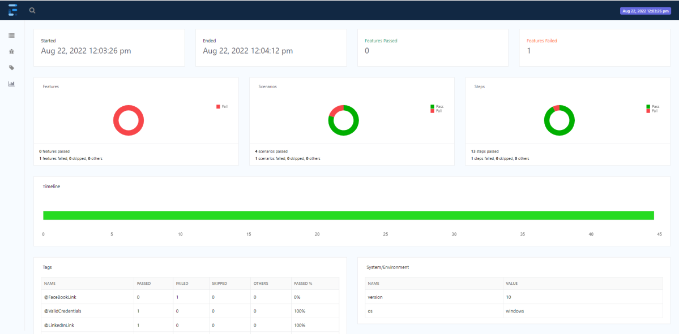
Spark Report
Right-click and open the Spark.html report with Web Browser.

